Slide 1




Week 9: Stance annotations and cohesion in dialogue
Ryan Ka Yau Lai
University of California, Santa Barbara

Slide 2

Before we start …
Open sbc007.rez
If you have a file saved from previous classes, please open that
If not, just open sbc007
Also, please go to Canvas and download stance_anno.json from section materials
If you still remember how to load it into Rezonator, then please do that (& help your friends!)
And take note of the question + codeword on the board!

Slide 3

Question for today
Find TWO strategies for achieving cohesion from a span of ~10 lines in SBC007, and explain how each of them connects different parts of the discourse together.

Slide 4
After today, you will be able to …
Connect
Connect the different themes covered by the course together
Describe
Describe how different strategies help speakers achieve coherence in discourse
Appreciate
Appreciate the diversity of strategies for achieving cohesion across individuals, communities, and cultures
Annotate
Annotate stance in Rezonator

Slide 5

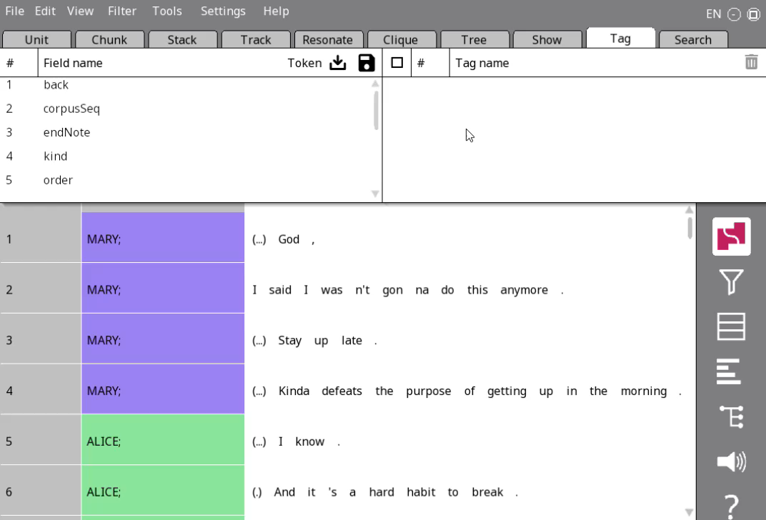
Adding a tag scheme (again)
Go to the Tag tab in the nav window
Click on the load icon
Navigate to your stance_anno.json file and select it (not shown in video)
Change the Token next to to unit, and find a new field under Chain: stanceComponent (note: the ‘stance’ field, if you see one, is an error caused by a Rezonator bug)

Slide 6
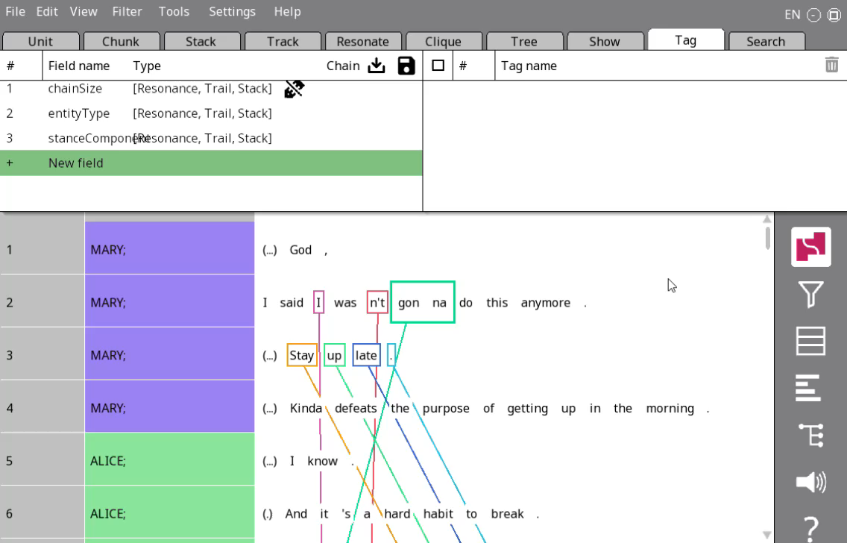

Changing visible columns (again)
Change to one-to-one mode
Navigate to the Chain tab
Click on the entityType column name, click Select field and choose stanceComponent

Slide 7
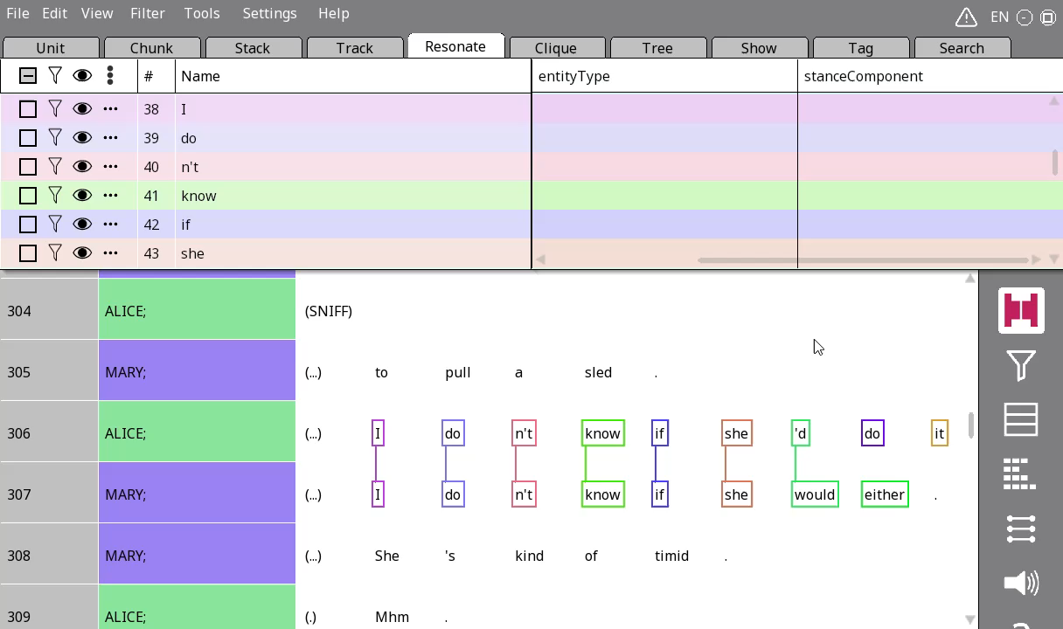

Annotating stanceComponent
Just click on the three dots and choose the appropriate component of the stance triangle
You can put non-resonating elements in single-rez resonances

Slide 8

Your turn!
Go to lines 283-291.
Annotate the resonance, and put the stance-related non-resonating words in rezzes as well.
Annotate each resonance according to their role in the stance triangle.

Slide 9
Think about the things we’ve learnt about …
Trails
Accessibility
Identifiability
Resonance
Stance alignment and differentials
…
Interjections & pragmatic markers
Ellipsis

Slide 10

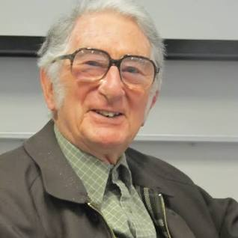
Anyone remembers this quote?
A text (discourse), we have suggested, is not just a string of sentences. In other words it is not simply a large grammatical unit, something of the same kind as a sentence but differing from it in size - a sort of supersentence. A text is best thought of not as a grammatical unit at all, but rather as a unit of a different kind; a semantic unit. The unity that it has is a unity of meaning in context, a texture that expresses the fact that it relates as a whole to the environment in which it is placed. (Halliday & Hasan 1976)

Slide 11


What makes a conversation sound like a conversation, and not just a random string of sentences?

Slide 12
What makes a conversation sound like a conversation, and not just a random string of sentences?
Trails
Accessibility
Identifiability
Resonance
Stance alignment and differentials
…
Interjections & pragmatic markers
Ellipsis

Slide 13
Accessibility
?
Identifiability
Once we’ve opened a cognitive file, no need for another one
Interjections
Respond to previous context, project following content
Resonance
Use previous talk as a framework (frame resonance) to present related, different content (focal resonance)
Trails
We continue to talk about the same things over a stretch of talk
Ellipsis
No need to say something obvious to everyone
Stance alignment
Engage with other people’s thoughts, feelings, beliefs …

Slide 14
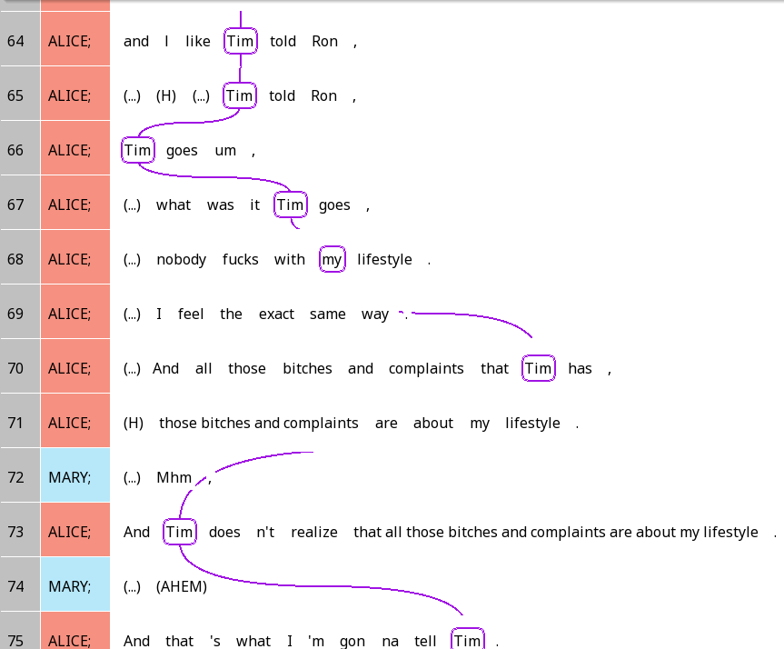
Imagine if SBC007 looked like this …

Slide 15
The repeated name penalty
More explicit form = easier to understand?
Well, not always …
If you keep naming something explicitly, it’s actually harder to understand
Choosing a shorter, less detailed referring expression for a high-accessibility referent makes the discourse easier to understand
Because you’re showing the relationship between different parts of discourse!
Choosing a referring expression according to referent accessibility helps us achieve cohesion.

Slide 16
A final cohesive device: Conjunctions
Small words used to connect different parts of discourse
Unlike interjections, cannot really stand alone
Can be a set phrase (by the way, with this in mind)
Common even in writing
Conjunctions
Additive
Adversative
Causal
Temporal

Slide 17
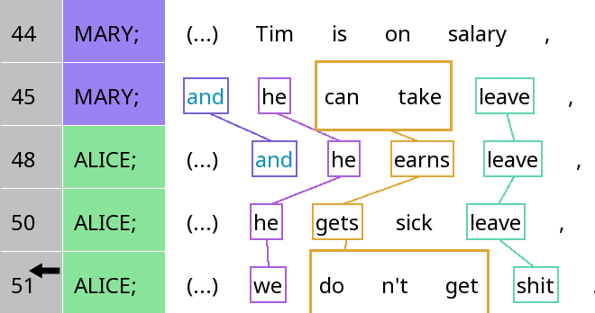
Conjunctions – Additive conjunctions

Slide 18
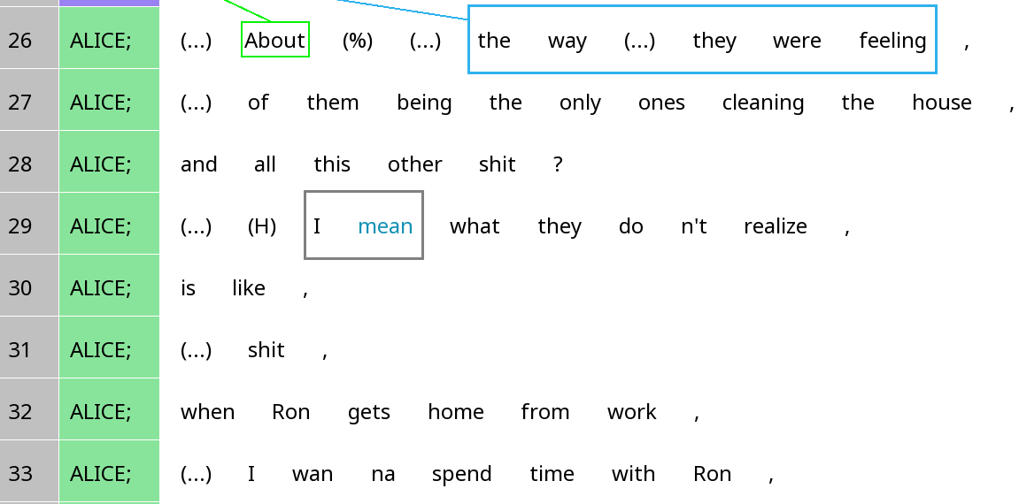
Conjunctions – Additive conjunctions

Slide 19
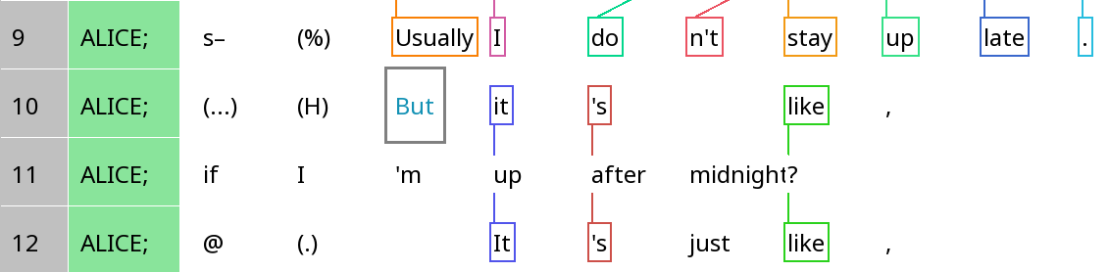
Conjunctions – Adversative conjunctions

Slide 20
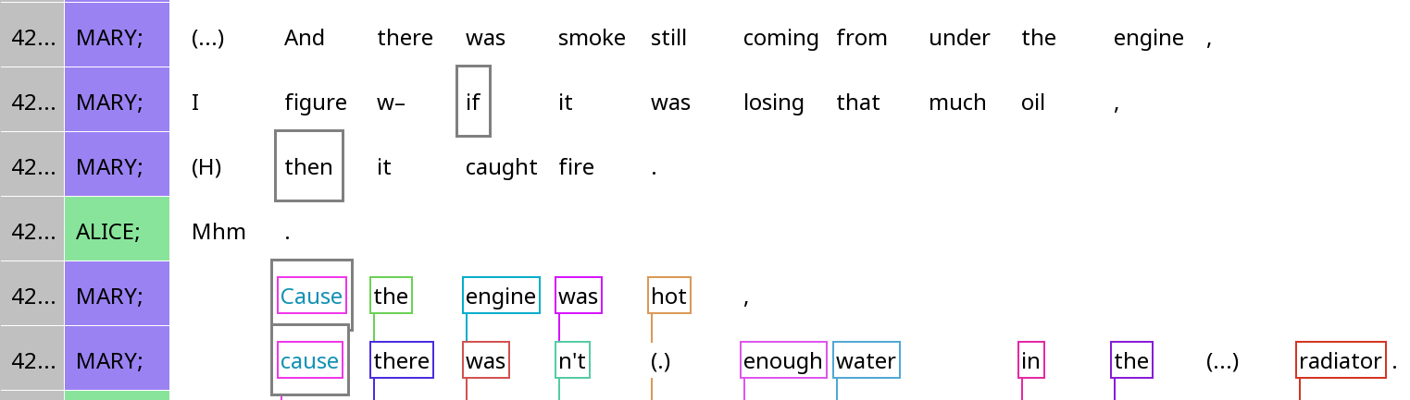
Conjunctions – Causal & temporal conjunctions

Slide 21

Cohesion in Eliza

Slide 22
Cohesion in Eliza
Appropriate indefinite expression for non-identifiable referent
v
Extensive frame resonance, correctly changes person (I/you)

Slide 23
Cohesion in Eliza
What’s the identifiable referent?
No use of higher-accessibility expressions or ellipsis
No conjunctions or interjections

Slide 24

Have things got better?
You can explore this for extra credit …

Slide 25

Your turn!
Look for a span of ~10 IUs in the Santa Barbara Corpus.
Identify three strategies for achieving cohesion used in the excerpt. You can take concepts from anywhere in the course.
Share with your group members what strategies you’ve found. In each case, you should name: a) the linguistic expressions involved and b) how the linguistic expressions help us connect different parts of the discourse together.

Slide 26
Do different people, communities, cultures do cohesion differently?

Slide 27
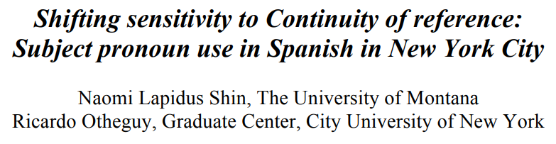
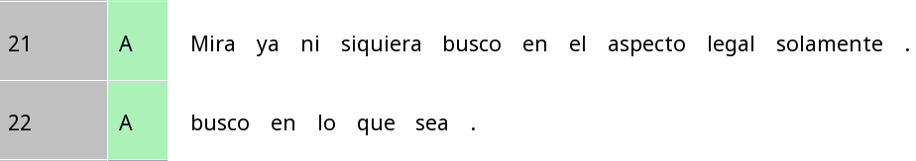
Spanish in NYC vs. Spanish in Latin America
Look (I) am not even looking just in the legal aspect.
(I) am looking everywhere.
Mira (yo) ya ni siquiera busco en el aspect legal solamente
look (I) already not even look in the aspect legal only
(Yo) busco en lo que sea.
(I) look in that which be
Is the choice whether to use pronouns the same for everybody?

Slide 28
Same reference vs switch reference
Same reference
Switch reference
Subject of previous clause = subject of current clause
Int: ¿Y tu papá terminó su licenciatura? (And your dad finished his Bachelor’s?) Part: Nada más. (Nothing more.) <0> se dedicó a otras cosas,
((<0>) dedicated himself to other things,)
Subject of second clause has ____ accessibility
Subject of previous clause = subject of current clause
Part: Ella tenía su novio allá (She had her boyfriend there) y él pensaba venir (And he thought about coming)
Subject of second clause has ____ accessibility

Slide 29
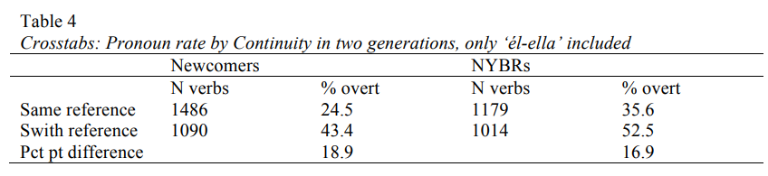
Do accessibility shape referring expressions the same way for everyone?
All subject pronouns | First-gen | Second-gen
Same reference (more acc.) | 23.3% | 31.9%
Switch reference (less acc.) | 37.8% | 41.7%
Difference | 14.5% | 9.8%
Second-generation Latinos in NYC use pronouns more overall
Less affected by accessibility

Slide 30
Do communicative ease shape these differences?
Third-person only | First-gen | Second-gen
Same reference (more acc.) | 24.5% | 43.4%
Switch reference (less acc.) | 35.6% | 52.5%
Difference | 18.9% | 16.9%
First/second-person only | First-gen | Second-gen
Same reference (more acc.) | 26.0% | 35.7%
Switch reference (less acc.) | 43.% | 48.4%
Difference | 17.7% | 12.7%
Second-gen speakers less sensitive to accessibility in first/second person contexts, but not so much in third-person. Why?

Slide 31
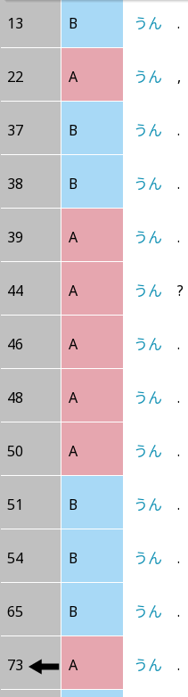
Backchannels in Japanese: Un
This is just one of many backchannels (aizuchi 相槌) …

Slide 32
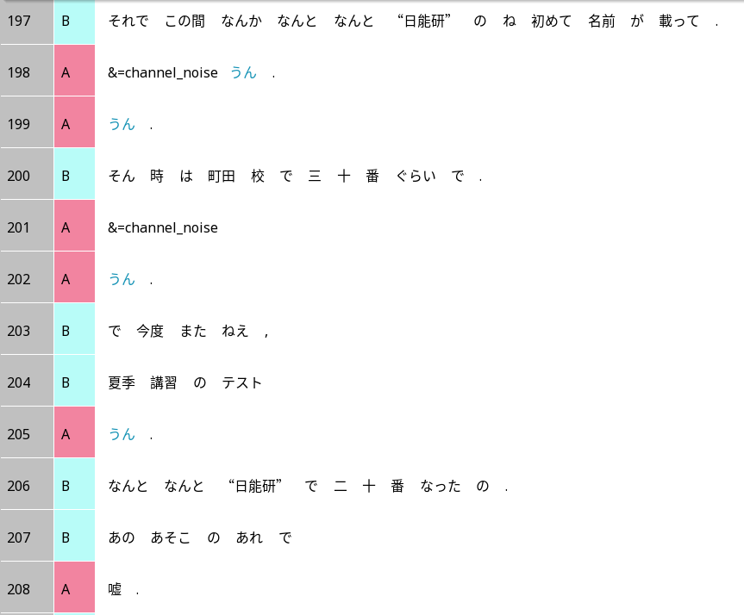
Backchannels in Japanese
Then recently there’s the Nichinouken thing, her name got mentioned for the first time and.
Un.
Un.
A backchannels even when B has not finished a complete utterance.
Line 205: A says ‘un’ even though B has not even produced a complete clause.
At the time she was around 30th in the Machida school and.
Un.
Then the next time,
The test of the summer course,
Un.
Surprisingly she became the 20th in the Nichinouken.
In that thing.
No way.

Slide 33
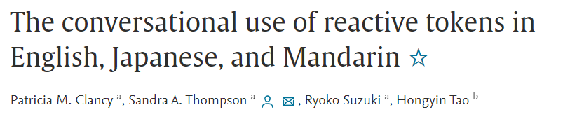
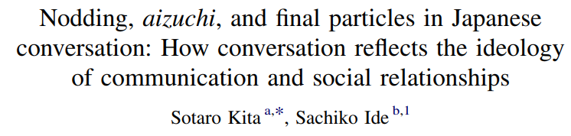
Japanese vs English/Mandarin
Japanese backchannels appear more frequently than English/Mandarin
Japanese backchannels can appear in more contexts than English/Mandarin, e.g. even when the other speaker is not finished
Function of backchannels in English and Mandarin:
Managing the floor: telling the other person ‘I understand, go on’
Function of backchannels in Japanese:
‘coordination for the sake of coordination, like dancing a waltz, through which a social bond between the participants of a conversation is established and maintained’ (Kita & Ide 2007)

Slide 34
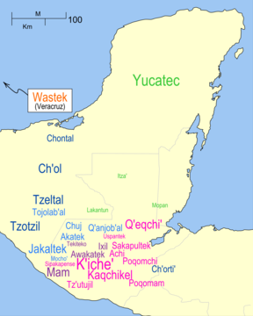
Mayan languages

Slide 35
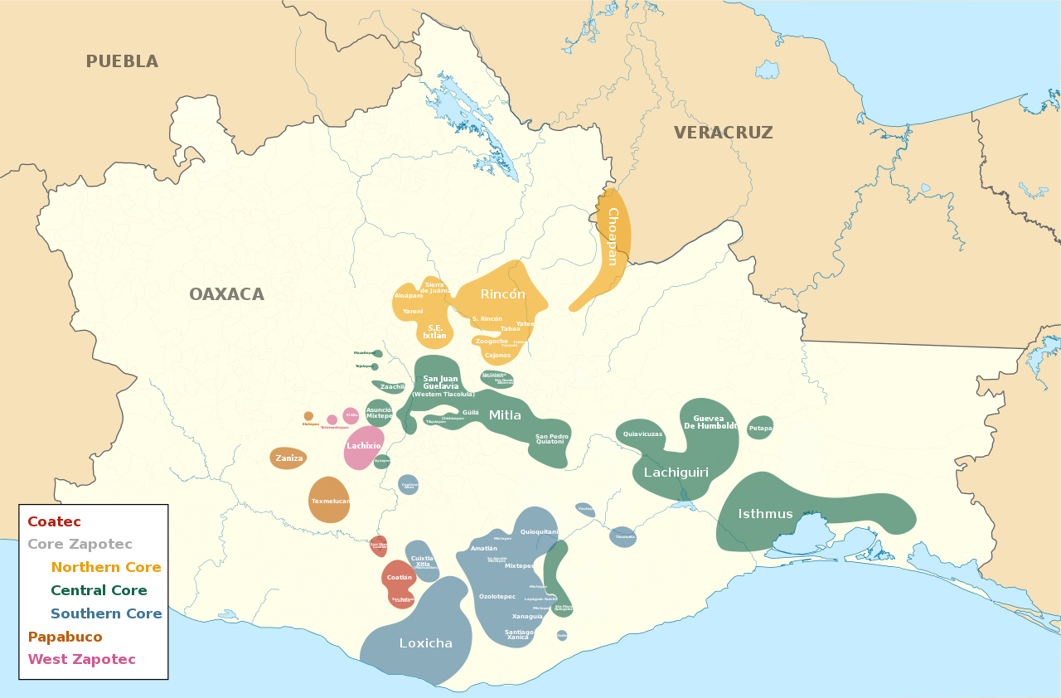
Lachixío Zapotec

Slide 36
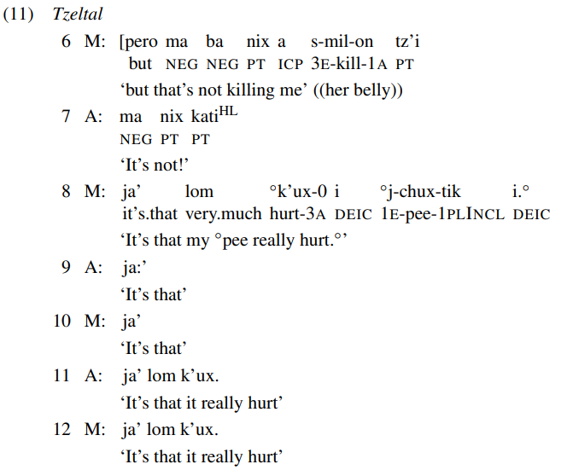
Resonance in Mayan languages
Mayans often use resonance where most other languages prefer interjections (e.g. yes/no, backchannels)
Also found in Zapoteco
From Enfield et al. (2018)
Q: What does this resonance tell you in terms of stance alignment?
Is it different from English (as we saw in the readings)?

Slide 37
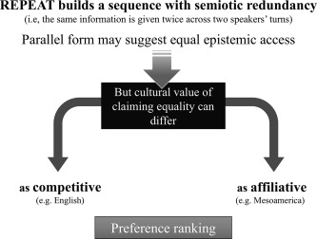
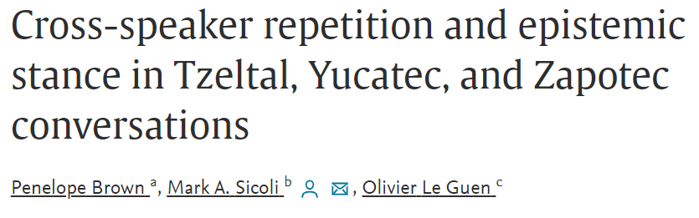
Resonance and stance in Mayan languages and Zapoteco vs. English
Tzeltal, Maya and Zapoteco speakers use resonance more frequently than English speakers
Tzeltal, Maya and Zapoteco use resonance more frequently to express agreement

Slide 38
Autism and cohesion
Neurotypical and neurodiverse children resonate in English in different ways (echolalia) (e.g. Du Bois, Hobson & Hobson 2014)
Neurotypical and neurodiverse children choose to use pronouns in different situations (e.g. Sterponi & de Kirby 2016)

Slide 39
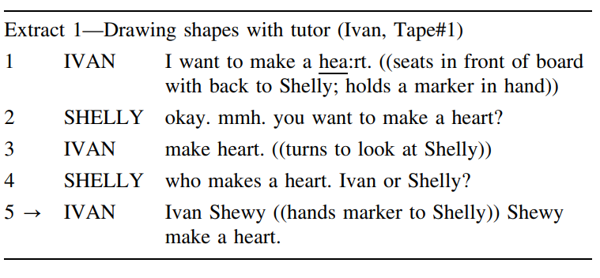
Autism and cohesion
Sterponi & de Kirby (2016)
Atypical pronoun use can be attributed to factors like frame resonance
Atypical resonance patterns are functional, dynamic, responsive to context
Discourse-analytic perspective helps us move beyond deficit framing of autistic children’s linguistic competence

